Slide 1
Socal Media
Audit

Slide 2
Table of contents
01
02
03
04
05
06
Objective
About competitors
Linkedin
Discussing the objective of the Social Media Audit
Getting to know about the competitors for making analysis
Analysing linkedin profiles to draw conclusion and prediction
Facebook
Observations and solutions
Links and references
Analysing facebook profiles to draw conclusions
Based on conclusions from analysing data, making observations and generating solutions
All the links and references of data used to draw conclusion

Slide 3
Objective
01
Discussing the objective of the Social Media Audit

Slide 4

Our objectives
1.
2.
3.
Track and document social media activity of ByteBlanket and its competitors across all the platforms
Analyse activity and growth and draw conclusions
Create a plan with suggestions which will help the growth by coming up with new campaigns and events.

Slide 5
02
About competitors
Getting to know about the competitors for making analysis

Slide 6

Specialising in banking software development, implementation, and support with special focus on Temenos T24, ABRIS is a prime IT operations partner for Financial Institutions implementing, upgrading or customizing their Temenos core and on-line platforms. With more than a decade of experience in supporting core banking projects, and developing both packaged and customized support tools, ABRIS delivers high quality results based on expert knowledge, extensive experience and an unwavering dedication to customer satisfaction.
ABRIS
Year Founded : 2014
LinkedIn followers : 598
Facebook followers : 198

Slide 7

Bank-Genie is FinTech based out of Singapore. Its focus is enabling Digital Transformation at Banks and Financial Institutions, via its Genie-Transformation Suite of Products. It enables MFI's to serve the unserved, underserved population, and at the same time enables Commercial Banks to serve their Customers. The aim of their products is to maximize Reach & Grow Footprint, Greatly reduce Servicing & Operating Costs, customer Delight, Retention, and Widening & Deepening Relationships.
Bank Genie
Year Founded : 2016
LinkedIn followers : 751
Facebook followers : 331

Slide 8

Byte Blanket is a generic technology, research and solutions startup currently focused in the areas of digital e-commerce application development and management, social media application development, enterprise software development, and the related disciplines of research and consulting.
Our Company
Byte Blanket
Year Founded : 2019
LinkedIn followers : 487
Facebook followers : 140

Slide 9
03
Linkedin
Analysing linkedin profiles to draw conclusion and prediction

Slide 10
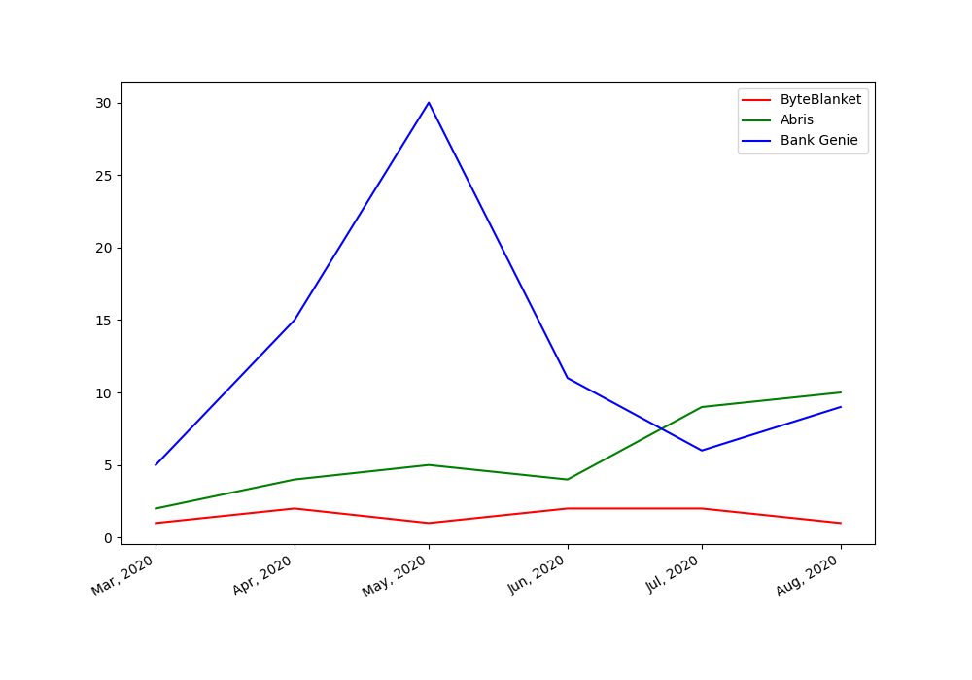
Linkedin
LinkedIn is most used Social media application by the professionals, so It is important to keep presence and be active because being interactive and active. This can help in increase of followers and can give rise to new opportunities and can project the work culture of the company for anyone looking to join the company. We have compared the presence and activity of our competitors.
Here you can see that Byte Blanket has less presence on linkedin than Abris and Bank Genie

Slide 11
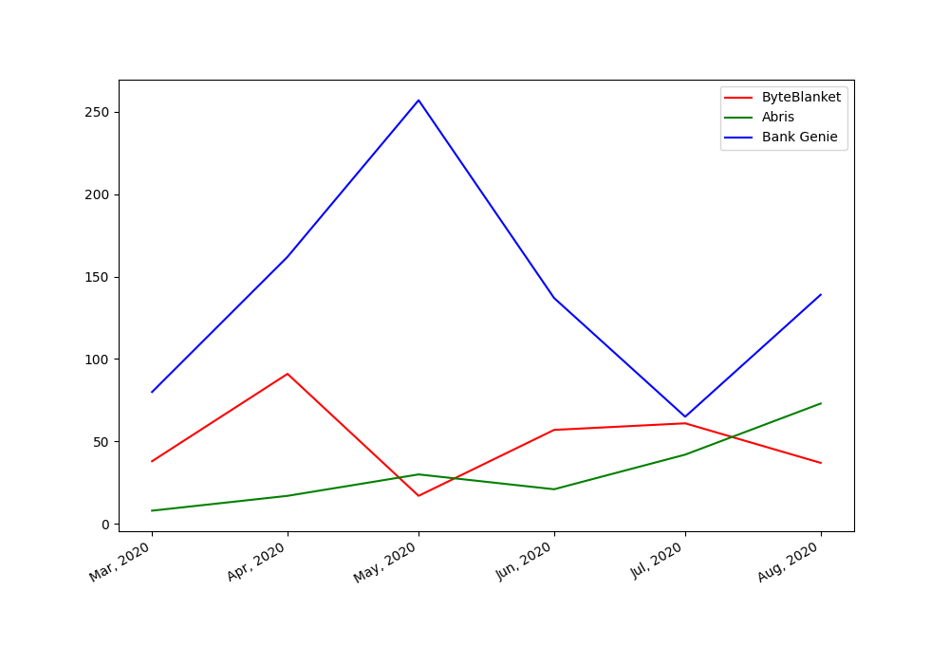
Linkedin
Apart from having presence on LinkedIn it very important to get people to interact with the posts as,more activity on every post can result to a better reach of a post and can attract more people to the ByteBlanket profile which will further result in increased overall presence.We have compared monthly interaction of our competitors.
The graph depicts that we have better monthly interaction than Abris but not as good as Bank Genie

Slide 12
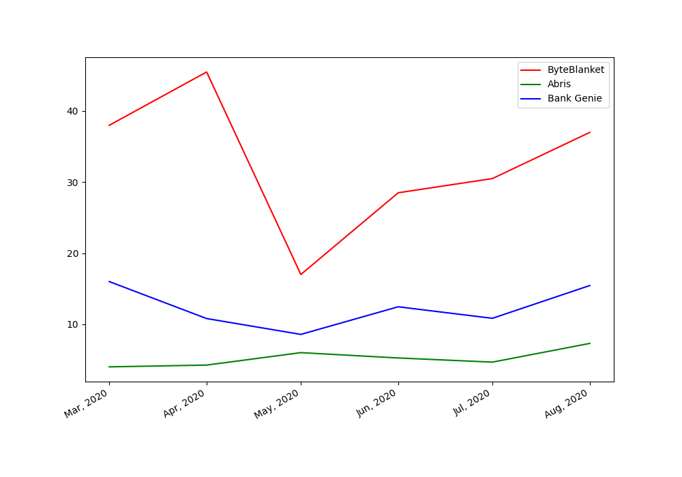
Linkedin
The previous graph only depicts the monthly interactions on our posts but we can make a conclusion by plotting on average likes on each post every month.we have compared the metric among our competitors.
This shows we have more interaction on individual posts than our competitors every month.

Slide 13
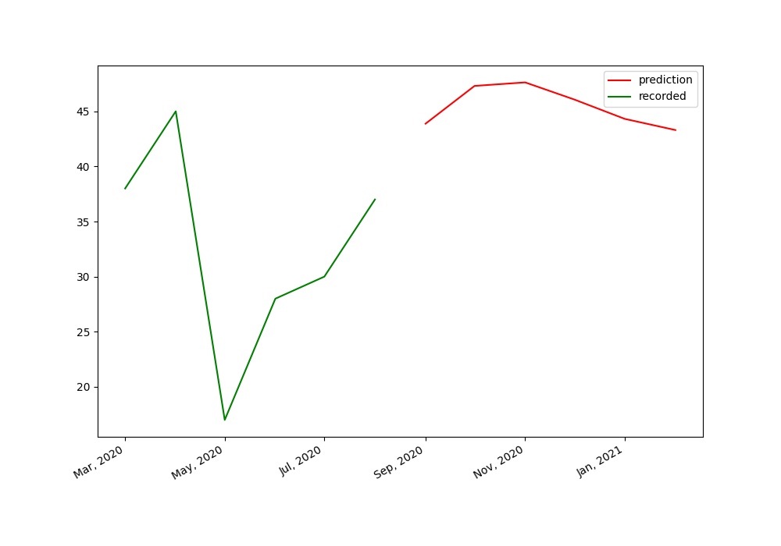
Linkedin
On the basis of data collected we can make time series prediction model to predict the trends in the near future if we keep running our linkedin profile like we are running now.We used LSTM from keras to make prediction and predicted for next 6 months
As we can see that there is an increasing trend predicted by the LSTM model.

Slide 14
04
Facebook
Analysing Facebook profiles to draw conclusion and prediction

Slide 15
Facebook
Facebook can be used to spread the awareness among your existing and potential customers. It can be beneficial for a company in many ways. For an instance, once someone likes a facebook page, he/she will receive updates whenever anything is posted. The company employees are motivated to like and share the posts thus multiplying the reach.
Apart from this, facebook attracts extra traffic to the company website. How? We can simply mention the company website. The interested people would visit the website and thus getting to see more relevant content. By looking at factors like number of likes and shares and age group of people visiting the site, company can be benefited in order to post efficient advertising and campaign content.

Slide 16
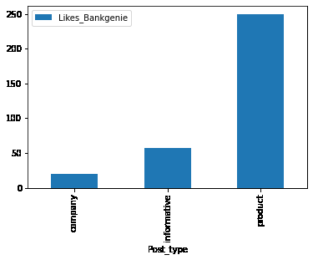
facebook
The frequency of posts affect the number of audience. Apart from posting text, we can also share the the pictures and videos of workplace, products and other informative content which is a very good way of communicating with the existing customers as well as potential ones, that too without personally visiting them.

Slide 17
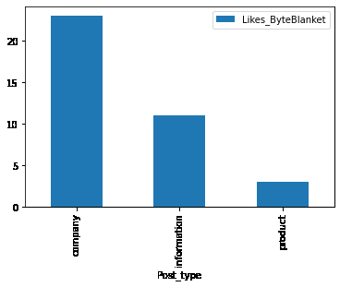
FAcebook
The number of likes are also dependent on frequency of post and how much relevant content is there. The number of likes on respective category of post reflects the interest of people. In this case, the amount of posts concerning the product are less and thus the number of likes are also lesser.

Slide 18
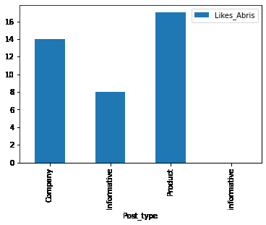
FAcebook
The posts related to products seemed to be the luring ones in this case. Apart from sharing about the products and company in order to have a good traffic on the page, it is good to share informative posts as well. The ones that directly indirectly are in interest of the company field.

Slide 19
05
Observation and Solutions
Based on conclusions from analysing data, making observations and generating solutions

Slide 20

Observations
When compared to the our competitors, we have a better presence taking into account that they are older than us.
Bank genie has more interaction on posts related to products and are found posting frequently which is resulting in more spread about their product.
Byte blanket has least number of posts on their product among the other categories and also among all the competitors, we need to increase the frequency of posting about our products.
Also Byte Blanket has very less presence on facebook, there are several months without any posts on the platform, unlike our competitors who have good frequency of posts.
Videos tend to have better reach than image but it is important to keep video small and conclusive as people don’t prefer to watch lengthy videos.
Companies also repost any content shared by their employees which they think is insightful ,which shows good relations between management and employees.
Also it can be seen that it is very important for employees to interact by liking or sharing the posts,which does not happen as interaction are less than number of employees.

Slide 21
Proposed Solution
We need to increase number of posts on all our platforms.
We need to increase the posts that promote our products.
Companies have large number of followers but very less interactions on their posts, which can be prevented early by posting frequently and diversifying the posts that we put out.
We can also make posts about ongoing events in the company like product launch, promotion, new recruitment,festivals of all ethnicities,supporting ongoing social events.
We also need to Employees to interact with the posts by liking or sharing which is increase reach as currently ByteBlanket has 200+ people working but no posts has interaction more than 100, this can be one of the simplest ways of increasing our presence.
Social media platforms provide paid services for marketing which can help us reach the target audience.

Slide 22
06
Links and references
All the links and references of data used to draw conclusion

Slide 23

Links and references
Datasets and other files :https://drive.google.com/drive/u/3/folders/1vB7-DDL-OCXj2nLxOkuEsBLGhF0MhZKG
Link for the code :
https://colab.research.google.com/drive/1lnvH5nWXydmZPW4pqqtY9NpS6wSj_vUu#scrollTo=o-nkerWgeGtM
Abris linkedin Abris facebook
Bank genie linkedin Bank genie facebook

Slide 24
Thank YOU
By :
Anirudh Joshi
Aabha sharma

